Slide 1
Maven Toy Data Analysis
A Comprehensive SQL-based Analysis of Toy Sales Data

Slide 2
Project Overview
Objective:
Analyze toy sales data to gain insights into inventory management, product performance, sales trends, and store operations.
Dataset Overview:
Four tables: Inventory, Products, Sales, and Stores.

Slide 3
Dataset Details
Tables:Inventory Table:
Store_ID, Product_ID, Stock_On_Hand.
Products Table:
Product_ID, Product_Name, Product_Category, Product_Cost, Product_Price.
Sales Table:
Sale_ID, Date, Store_ID, Product_ID, Units.
Stores Table:
Store_ID, Store_Name, Store_City, Store_Location, Store_Open_Date.

Slide 4
Problem Statement
Key Questions
Task
Analyze sales trends and patterns.
Evaluate inventory levels across stores.
Assess product performance across different categories.
Understand store-level operations and sales performance
Use SQL queries to answer 15 key business questions from the dataset.

Slide 5
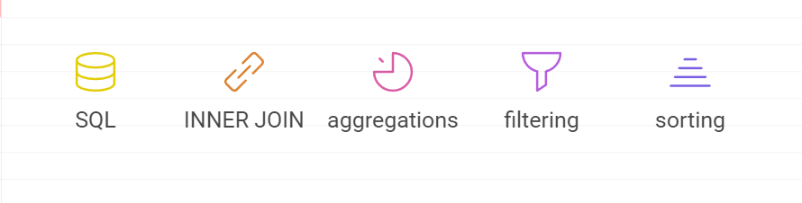
Tools and Techniques
Tools Used
Techniques
SQL for data extraction and analysis.
SQL Joins (INNER JOIN, LEFT JOIN, etc.)
Aggregation Functions (SUM, COUNT, AVG, etc.)
Filtering and Sorting
Date Manipulation Functions

Slide 6
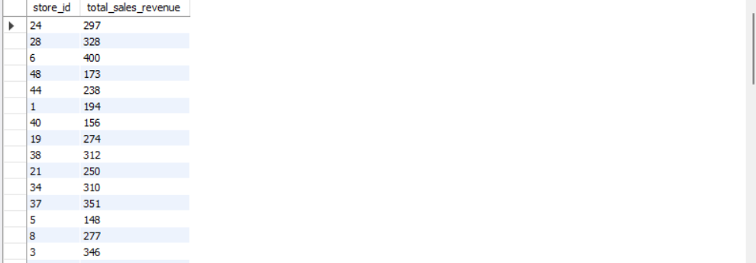
Total Sales Revenue by Store
Key findings:
Top performing store with Amount in salesHighlight top-performing stores
Lowest performing store with Amount in sales
Average store revenue:

Slide 7
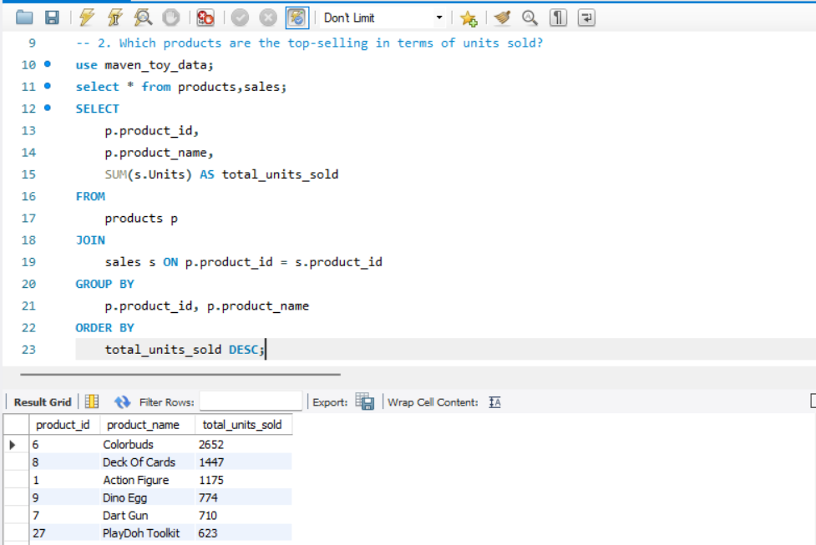
Top-Selling Products
Table of top 5 products by units sold

Slide 8
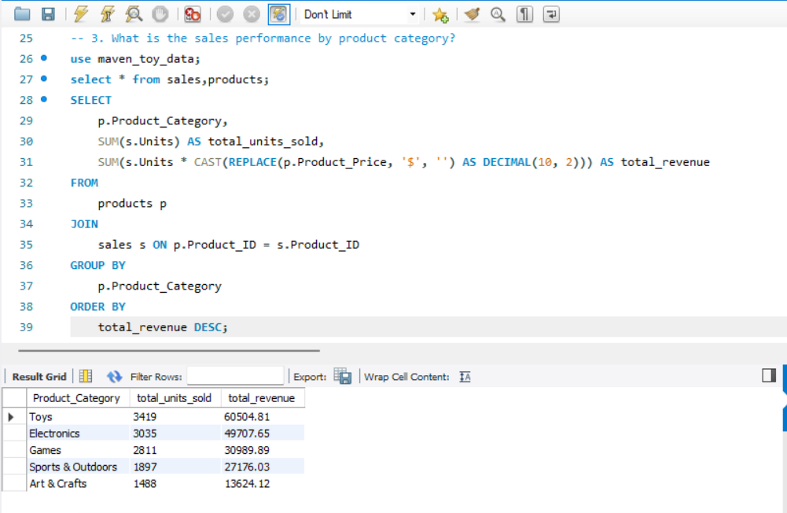
Sales Performance by Product Category
Highlight best and worst performing categories

Slide 9
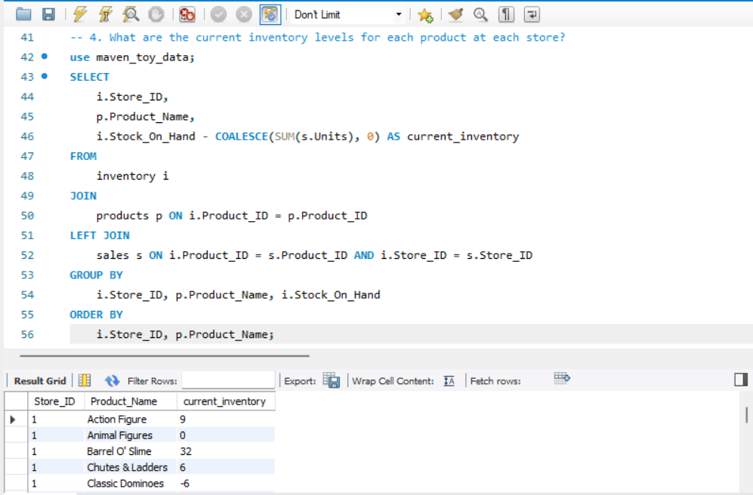
Inventory Analysis
Overview of current inventory levels
Products that are out of stock
Highlight stores with critical inventory levels

Slide 10
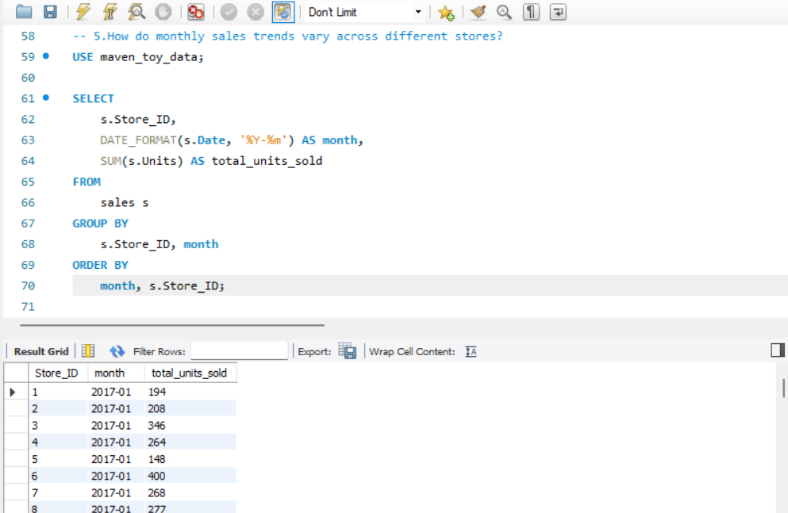
Monthly Sales Trends
Identify any seasonal patterns or growth trends
Note any significant events or promotions that might explain spikes

Slide 11
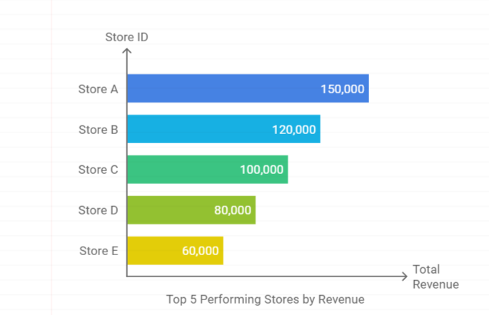
Store Performance Comparison
Comparison of highest and lowest performing stores
Factors contributing to performance differences (location, product mix, etc.)

Slide 12
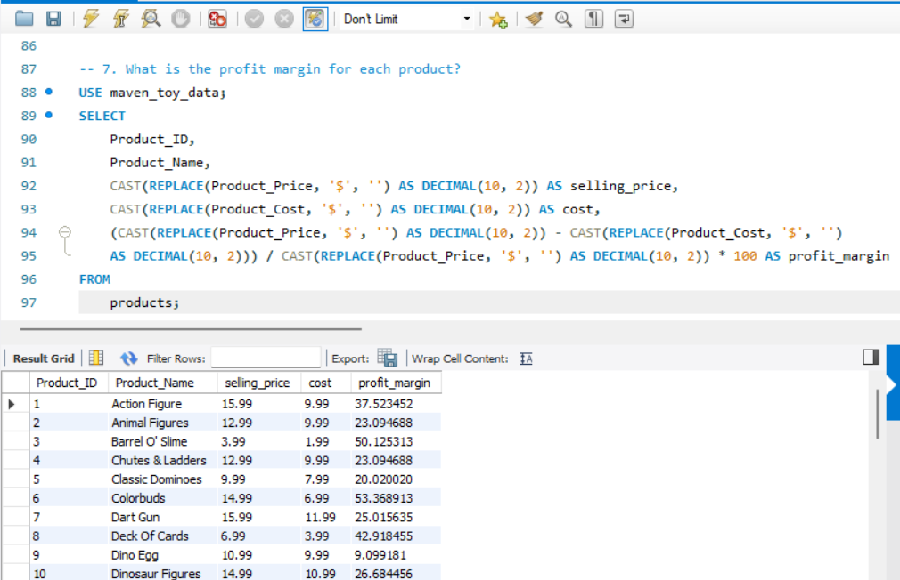
Product Profitability
Table showing top 5 products by profit margin
Brief explanation of how profit margin was calculated
Discussion on balancing high-margin products with sales volume

Slide 13
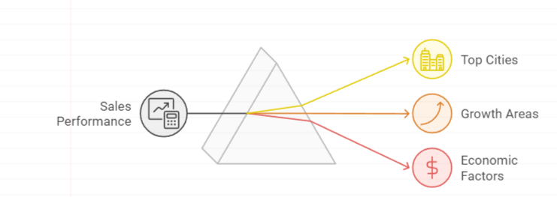
Sales Distribution by City
Identify top-performing cities and potential growth areas
Correlation with population density or local economic factors

Slide 14
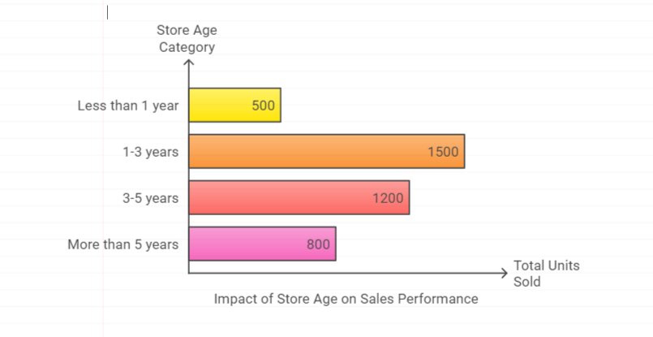
Impact of Store Age on Sales
Insights on how newer vs. older stores are performing
Discussion on potential reasons (establishment in the community, initial hype, etc.)

Slide 15
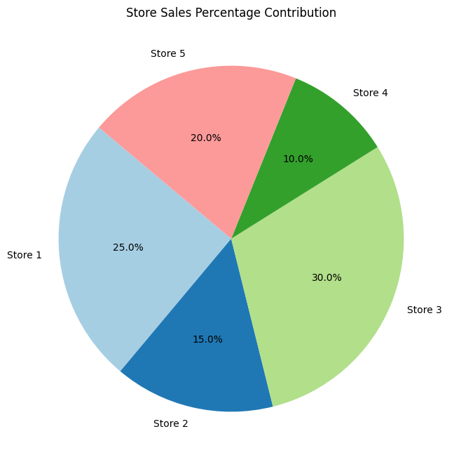
Store Contribution to Total Sales
Highlight stores with significant contributions
Discussion on potential for replicating success of top-contributing stores

Slide 16
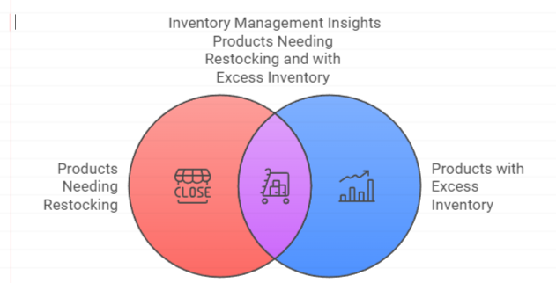
Stock Levels vs. Sales
Identify products that may need restocking or have excess inventory
Discussion on inventory management strategies
Comparison of current stock levels and sales for key products

Slide 17
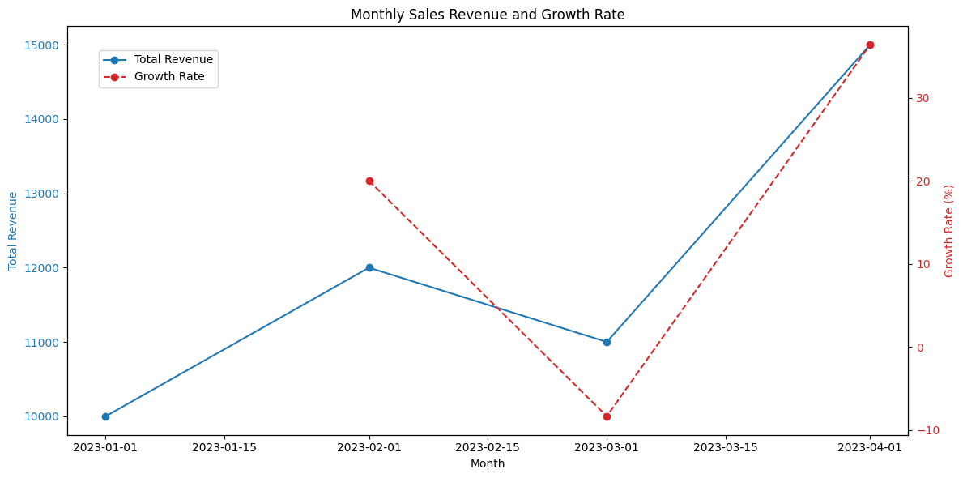
Sales Growth Over Time
Highlight significant growth periods or slowdowns
Correlation with external factors or internal initiatives

Slide 18
Key Insights and Recommendations
Key Insights
Recommendations
Store Performance Variability: There's significant variation in performance across stores, with some dramatically outperforming others.
Product Category Impact: Certain product categories contribute disproportionately to overall revenue.
Inventory Management Challenges: Some products are frequently out of stock, while others have excess inventory.
Seasonal Sales Patterns: Monthly sales trends indicate clear seasonality in purchasing behavior.
Store Age Influence: Newer stores show different performance patterns compared to more established locations.
Product Profitability: The most popular products aren't necessarily the most profitable.
Optimize Store Performance: Conduct a detailed analysis of top-performing stores to identify best practices.
Category Management: Allocate more resources and shelf space to high-performing product categories.
Improve Inventory Management: Implement a more responsive inventory system to reduce stockouts of popular items.
Seasonal Strategy: Adjust staffing and inventory levels to anticipate seasonal demand fluctuations.
Store Lifecycle Management: Provide additional support and resources to newer stores to help them ramp up quickly.
Profitability Focus: Promote high-margin products more aggressively to balance sales volume with profitability.

Slide 19
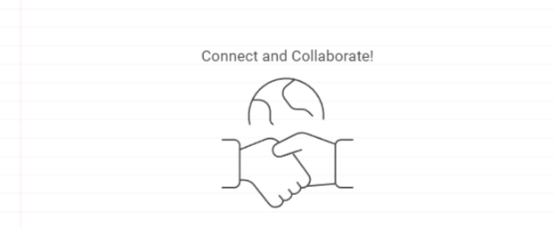
Thank You
Thank you for your attention
Free feel to ask Any questions.

